Slide 1
Arduino
Muhammad Rizwan

Slide 2
Micro-Controller
A single chip Computer
Has……
CPU
RAM
EEPROM
I/O in form of pins
Peripherals (Timer , Communication modes , ADC etc)

Slide 3
????
Suppose we want to make a Line following Robot
What do we do ?
Use a computer with 2.4 GHz Intel core i7 with 4 Gb RAM , 500 Gb Hard disk , 1 Gb Graphics Card ??

Slide 4
Why not a Computer ?•
PC is a general purpose computer.
Can run thousand of software's
Microsoft ppt in which you are seeing this presentation
Games (NFS , AOE , Call of Duty)
Highly expensive

Slide 5
Why MCU?
Small reflected by the word “MICRO”
Inexpensive
Ideal for doing repetitive tasks
Easy to use
Highly Efficient and fast

Slide 6
Selecting a MCU
Two family of MCU extremely popular
AVR
PIC
The instructions are fed once in the form of a Hex file

Slide 7
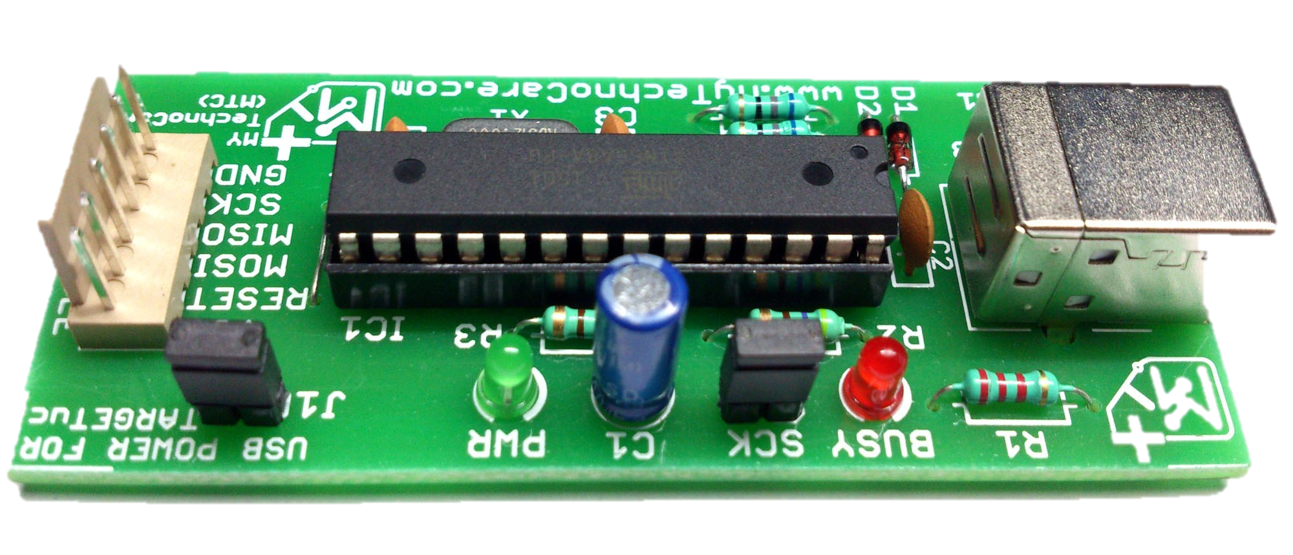
Microcontroller and Programmer

Slide 8
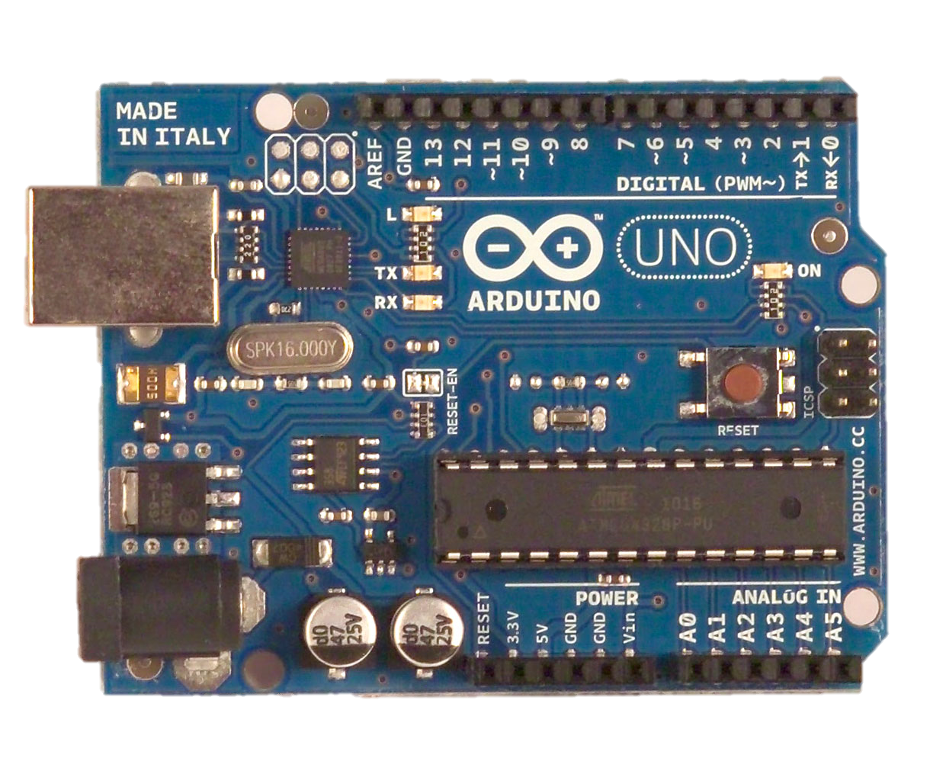
What is an Arduino ?
Open Source electronic prototyping platform based on flexible easy to use hardware and software.

Slide 9
Most popular Arduino Boards
Arduino Uno
Arduino Leonardo
Arduino Mega
Arduino Due
Arduino Micro
Arduino LilyPad
Arduino Yun

Slide 10
What can it do?
Sensors ( to sense stuff )
Push buttons, Touch pads.
Thermistors (temperature)
Ultrasound (proximity range finder)
Actuators ( to do stuff )
Lights, LED’s
Motors
Speakers
Displays (LCD)

Slide 11
Shields and Supports
Ethernet Shield
Relay Shield
Proto Shield [Permanent]
Motor Shield
Can Bus Shield [on board diagnosis]
Joystick Shield Kit
GSM / GPRS Shield
Micro SD Shield

Slide 12
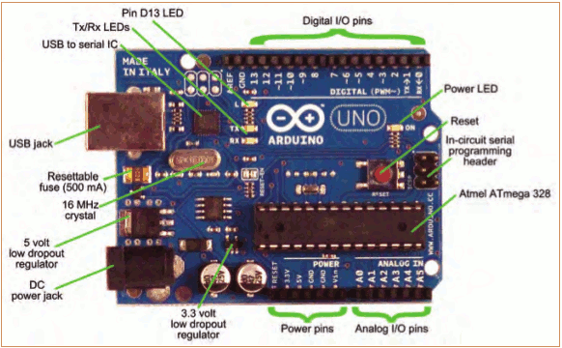
Meet Arduino Uno

Slide 13
Getting Started
Check out: http://arduino.cc/en/Guide/HomePage
Download & install the Arduino environment (IDE)
Connect the board to your computer via the USB cable
If needed, install the drivers
Launch the Arduino IDE
Select your board
Select your serial port
Open the blink example
Upload the program

Slide 14
Bare minimum code
void setup() { // put your setup code here, to run once:
}
void loop() { // put your main code here, to run repeatedly:
}
setup : It is called only when the Arduino is powered on or reset. It is used to initialize variables and pin modes
loop : The loop functions runs continuously till the device is powered off. The main logic of the code goes here. Similar to while (1).

Slide 15
PinMode
A pin on Arduino can be set as input or output by using pinMode function.
pinMode(13, OUTPUT); // sets pin 13 as output pin
pinMode(13, INPUT); // sets pin 13 as input pin

Slide 16
Reading/writing digital values
digitalWrite(13, LOW); // Makes the output voltage on pin 13 , 0V
digitalWrite(13, HIGH); // Makes the output voltage on pin 13 , 5V
int buttonState = digitalRead(2); // reads the value of pin 2 in buttonState

Slide 17
Analog to Digital Conversion
What is analog ?
It is continuous range of voltage values (not just 0 or 5V)
Why convert to digital ?
Because our microcontroller only understands digital.

Slide 18

ADC in Arduino Uno

Slide 19
ADC in Arduino
The Arduino Uno board contains 6 pins for ADC
10-bit analog to digital converter
This means that it will map input voltages between 0 and 5 volts into integer values between 0 and 1023

Slide 20
Reading/Writing Analog Values
analogRead(A0); // used to read the analog value from the pin A0
analogWrite(2,128);

Slide 21

Thanks.
Any Question?
?

